Slide 1

DES baseado na distância euclidiana para previsão dos casos de COVID-19
Jair Paulino, José Maurício
(jps4, jm)@cin.ufpe.br

Slide 2
Introdução

Slide 3
Abordagem proposta

Slide 4
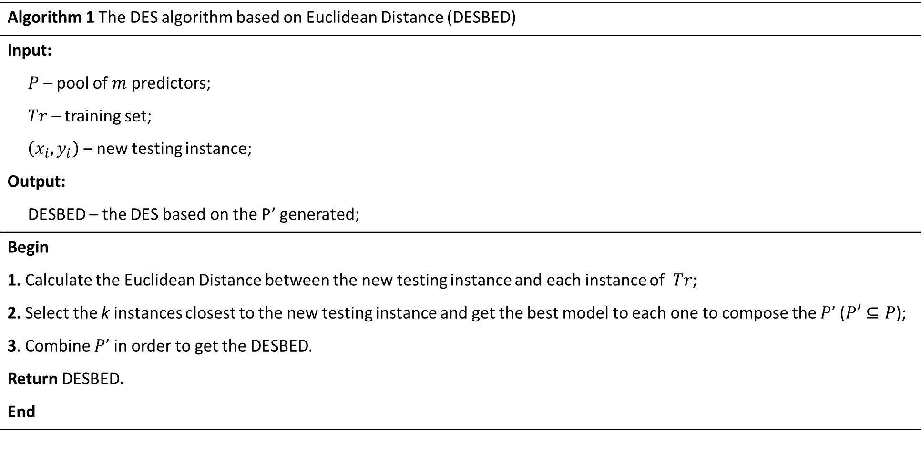
Algorithm 1 The DES algorithm based on Euclidean Distance (DESBED)
Input:
$P$ – pool of $m$ predictors;
$Tr$ – training set;
$\left(x_{i},y_{i}\right)$ – new testing instance;
Output:
DESBED – the DES based on the P’ generated;
Begin
1. Calculate the Euclidean Distance between the new testing instance and each instance of $Tr$;
2. Select the k instances closest to the new testing instance and get the best model to each one to compose the $P’$ ($P′⊆P$);
3. Combine $P’$ in order to get the DESBED.
Return DESBED.
End

Slide 5
Metodologia
I
II
DB
MLP_1
MLP_2
x
…
MLP_30
Exploratory data analysis
TS selection
cSA
III
cSM
Split
LSTM
Normalisation
DESBED
SW matrix
Performance

Slide 6





Training set
Test set
$$X_{training}$$
$$X_{test}$$
Generate a pool of predictors (P)
$$P=\left\{P_{1},P_{2},⋯,P_{m}\right\}$$
Calculate the Euclidean Distance vector (EDV)
$$EDV$$
Decision
k Predictors combination
$$P′$$
Select k models based on k-min(EDV)

Slide 7
Metodologia

Slide 8
Resultados

Slide 9
Conclusão

Slide 10



Obrigado!
Obrigado!
Obrigado!
Jair Paulino, José Maurício
(jps4, jm)@cin.ufpe.br

